Slide 1
Mid Semester Presentation
H. Nihar Nandan

Slide 2
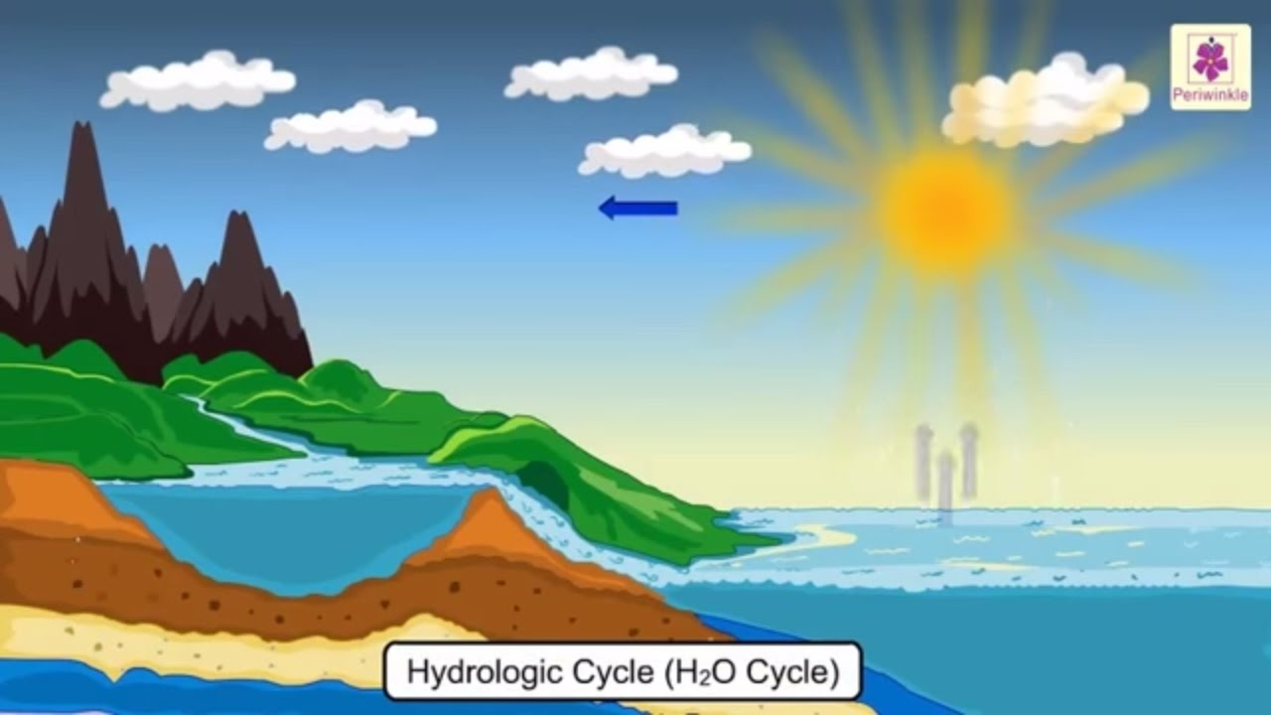
Motivation
Human impact on the environment continues to grow on a global scale, as the increasing land and water use and the rising concentrations of greenhouse gases in the atmosphere show. We can measure this impact by calculating the radiative forcing.
Radiative forcing - is the difference between insolation (sunlight) absorbed by the Earth and energy radiated back to space.
ENERGY FROM
SUN
AEROSOL LAYER
LAND
OCEAN
RADIATIVE ENERGY
DEEP OCEAN

Slide 3
Goal
We want to be able to model the sea-level rise but we also want to account for the uncertainties with correlated parameters.

Slide 4
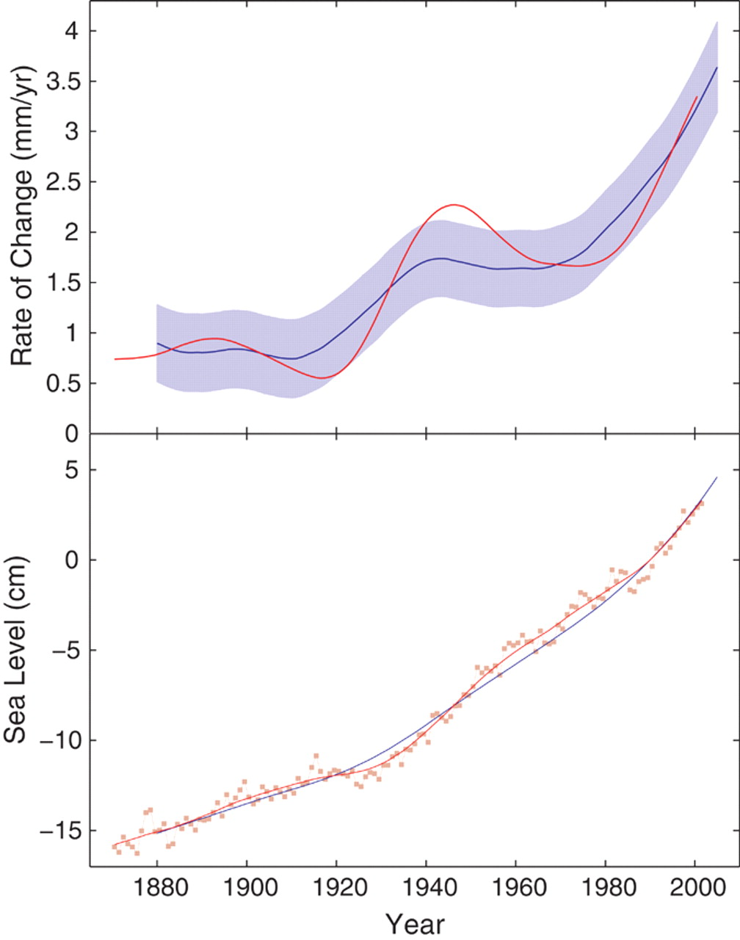
Sea-level Change
DOECLIM and GMSL model: the two of these combined gives a simplified model for how radiative forcing affect temperatures and in turn affects sea level.
DOECLIM – Diffusion Ocean Energy Climate Model
GMSL – Global mean sea level
(1)
Red - Rate of sea-level rise obtained from tide gauge observations
Blue band - the statistical error
(2)
Red squares - unsmoothed, annual sea-level data.
Rahmstorf 2007
Notes:
Add legend, reference.

Slide 5
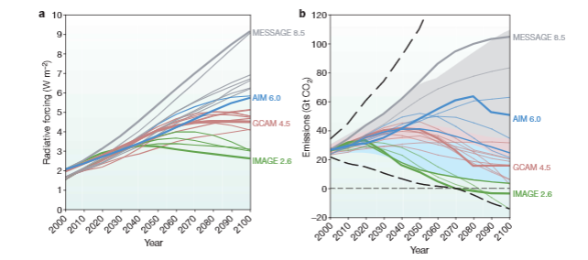
Future radiative forcing in difference scenarios
Moss et al 2010
Notes:
Remove this slide. Replace with RCP scenario plot and discussion (Moss et al 2010 pdf from tony)

Slide 6
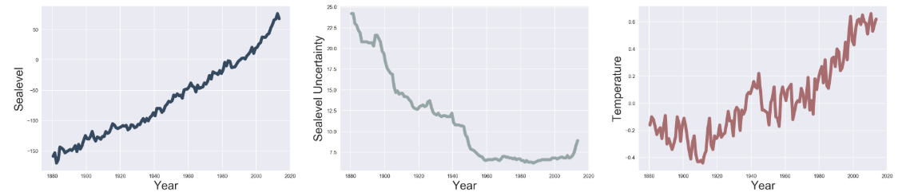
NOAA Data
NOAA -National Oceanic and Atmospheric Administration
We can see how an increase in radiative forcing has caused an increase in global mean temperatures and global mean sea-levels over the years.
Notes:
Make the connection between radiative forcing and this slide.

Slide 7

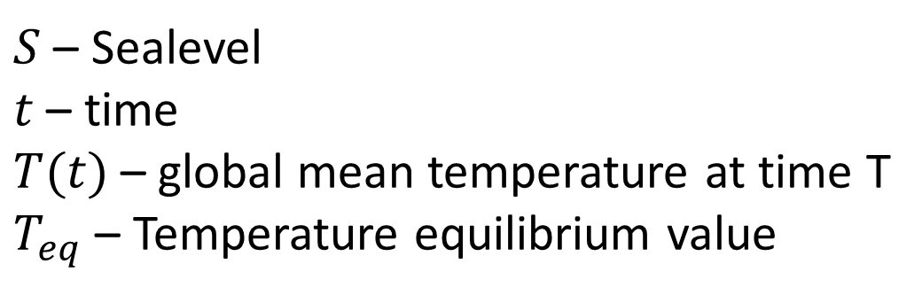
Equation to model Sea-level Rise -
  $\frac{dS}{dt}=α\left(T\left(t\right)−T_{eq}\right)$
  $S_{t+1}−S_{t}=Δt×α\left(T_{t}−T_{eq}\right)$
  First order forward Euler
  $S_{t+1}=S_{t}+Δ×α(T_{t}−T_{eq})$
  $d_{n}←S_{n}=S_{n−1}+Δt×α×\left(T_{1}−T_{eq}\right)$
$S$ – Sealevel
$t$ – time
$T(t)$– global mean temperature at time T
$T_{eq}$ – Temperature equilibrium value
Rahmstorf 2007
Notes:
add reference to Rahmstorf 2007 (Science paper)

Slide 8
Calibrating the model to the data
Temperature (from DOECLIM)
Ocean heat (from DOECLIM)
Sea-level (from GMSL)
  Data: Temperature (forcing, NOAA), Sea-level: (calibration)
Calibrate the model using the above data.
We have to design a likelihood function using these data sets.

Slide 9
The MCMC chain
We want to sample parameters from the posterior distribution. Simple Bayes’ likelihood function.
We want accurate projections, but along with the projections we also want to characterize the uncertainties
We’re doing this using MCMC chains -
5 parameters in our MCMC chain –
  Alpha (Sea-level sensitivity to changes in temp.)
  Temperature Equilibrium
  Initial sea level value of model
  Rho (Uncertainty in sea-level estimates)
  Uncertainty in AR1 matrix
The data that we use for the calibration are the sea-levels from the NOAA dataset.
Log-Likelihood function -
Notes:
We want to characterize the uncertainty on our projections. sigma_i in figure (likelihood). Change likelihood to include AR1 sigma.

Slide 10
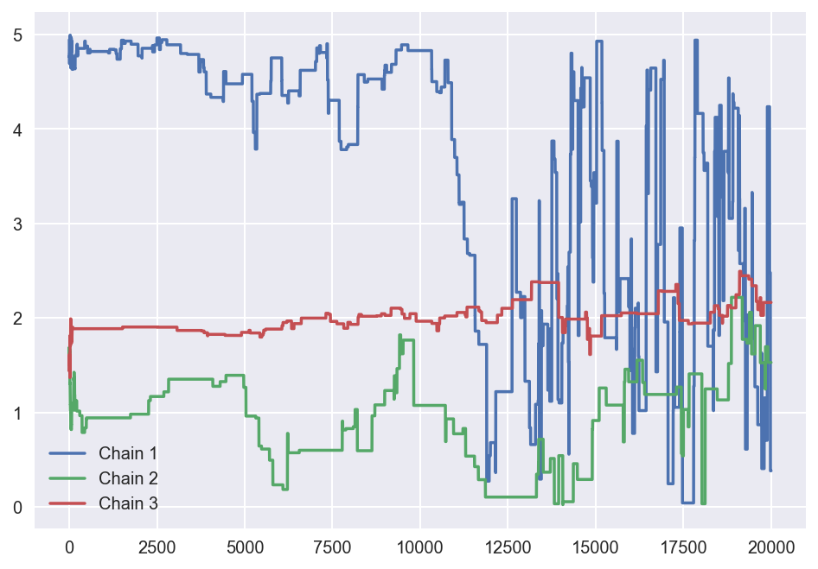
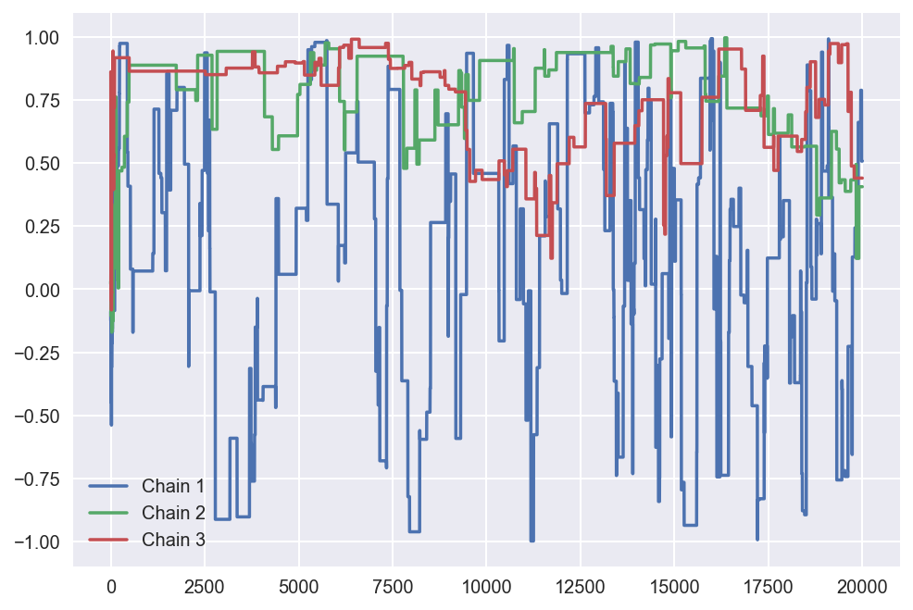
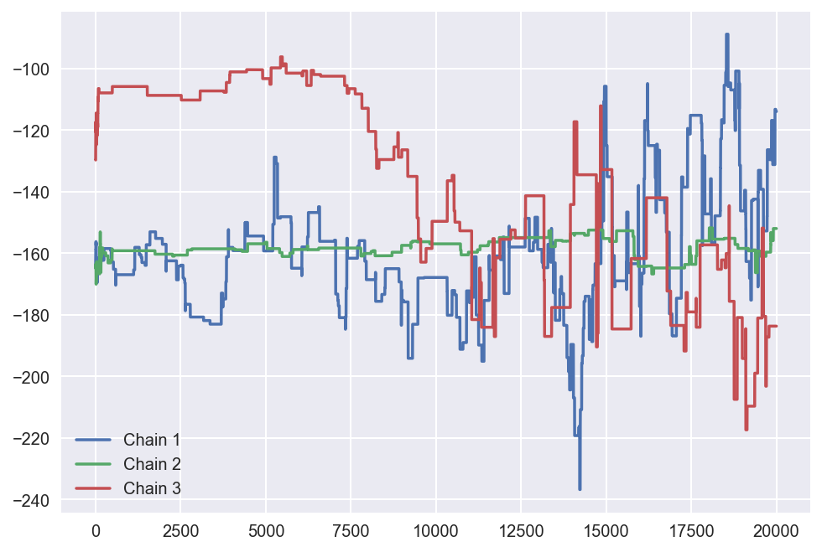
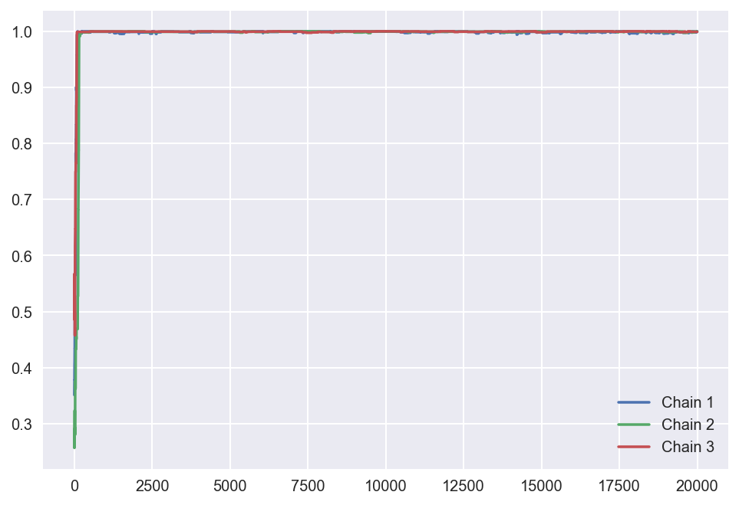
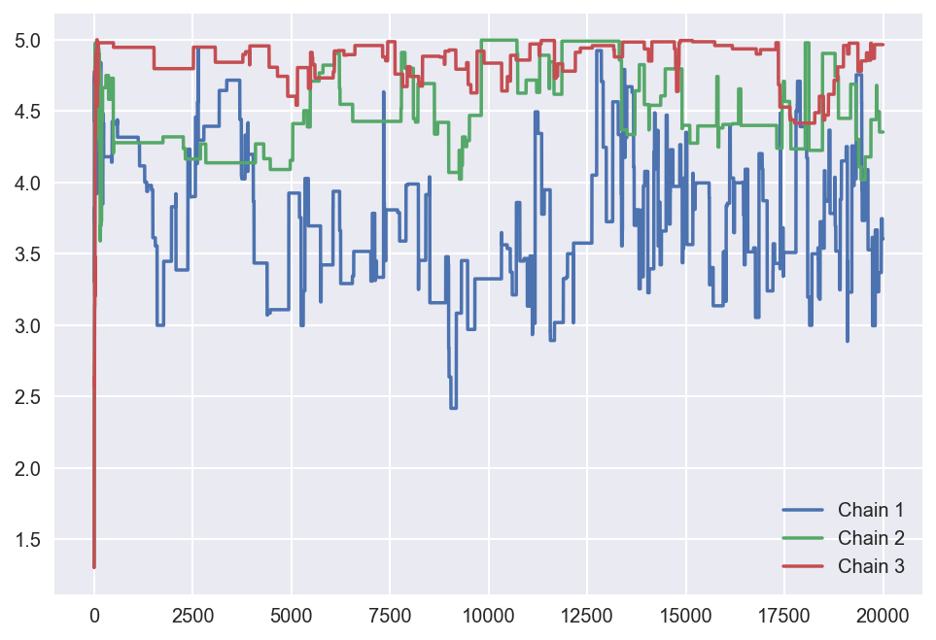
History Plots
Alpha
Teq
S_0
Uncertainty in
AR1 Matrix
Rho

Slide 11
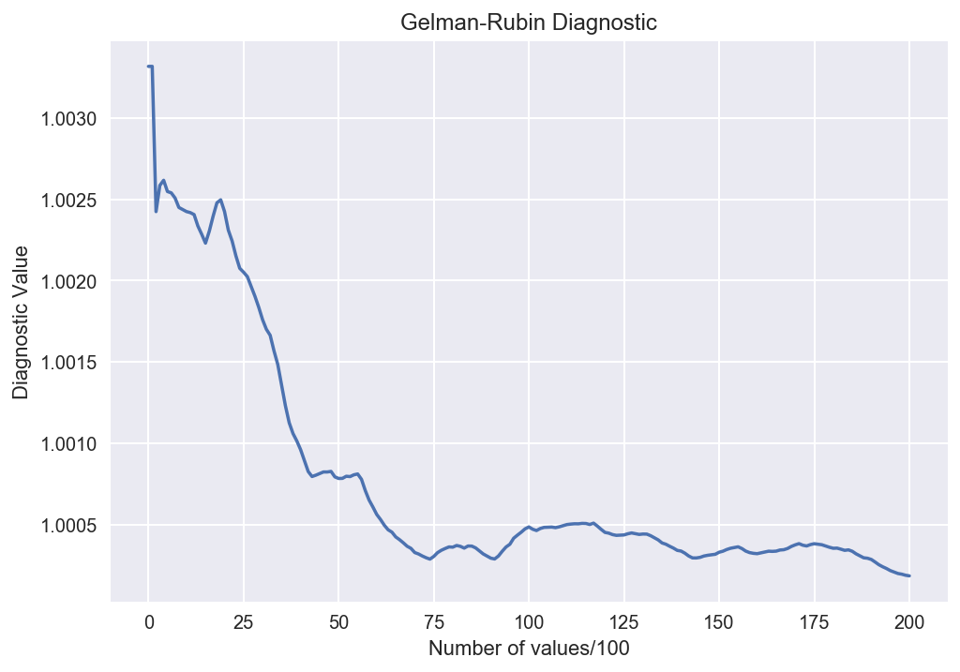
Gelman-Rubin Diagnostic

Slide 12
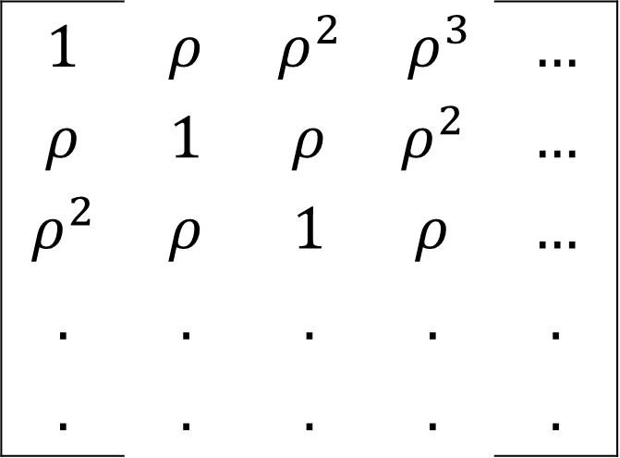
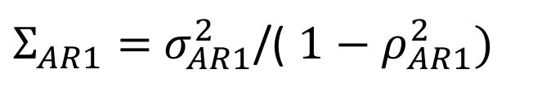
AR1 Matrix
$$1$$ | $$ρ$$ | $$ρ^{2}$$ | $$ρ^{3}$$ | $$…$$
$$ρ$$ | $$1$$ | $$ρ$$ | $$ρ^{2}$$ | $$…$$
$$ρ^{2}$$ | $$ρ$$ | $$1$$ | $$ρ$$ | $$…$$
$$.$$ | $$.$$ | $$.$$ | $$.$$ | $$.$$
$$.$$ | $$.$$ | $$.$$ | $$.$$ | $$.$$
$Σ_{AR1}=$ $σ_{AR1}^{2}$/( $1−ρ_{AR1}^{2})$
In the AR1 Matrix, we account for sea levels, but we want to account for the uncertainties for temperatures and ocean heat along with the correlated residuals.

Slide 13
Till now we’ve only done a model on the GMSL with a historical temperature data forcing the model with an AR1 process which has a single uncertainty parameter.
That work (and all others) assumed different data sets’ errors are independent.
  The advance we want to make is accounting for these dependencies
  show AR1 matrix with correlated uncertainties.
Previous work with DOECLIM+Rahmstorf GMSL
Use this better error structure than previous simulations and compare the differences with the new sea-level and temperature projections.

Slide 14

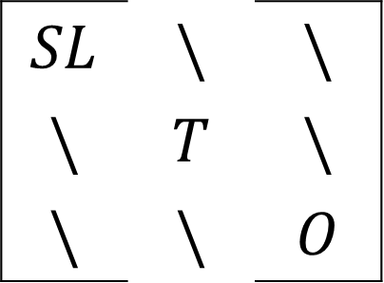
AR1 Matrix with correlated uncertainties
$$SL$$ | $$\backslash$$ | $$\backslash$$
$$\backslash$$ | $$T$$ | $$\backslash$$
$$\backslash$$ | $$\backslash$$ | $$O$$
Relation between SL and T.
This is a parameter that will
be a part of the MCMC Chain.
$$ε=$$

Slide 15
What’s been done -
MCMC model
DOECLIM model
Simple AR1 matrix with 0’s as off-diagonal values
What we’re going to do
MCMC model which takes in sea-level values and gives us estimates on temperature
Combined and easy-to-use python script
AR1 matrix which includes correlated uncertainties

Slide 16
Future Timeline
November –
  DOECLIM + GMSL model coupling (no calibration)
December –
  Finish combining DOECLIM model with the GMSL model and the calibration.
Jan – April – Experiments and error checking along with write-up.
End of April – Final defense

Slide 17

Building the AR1 Matrix
$φ_{n}=ρφ_{n−1}+Σ_{n}$
${var(φ}_{n})=var\left(ρφ_{n−1}+\backslash {epsilon}_{n}\right)$
$σ^{2}=ρ^{2}×σ^{2}+var\left(Σ_{n}\right)$
$σ^{2}=ρ^{2}×σ^{2}+σ_{AR1}^{2}$
$σ^{2}(1−ρ^{2})=σ_{AR1}^{2}$
Will put each variable means
Notes:
Just show the residual equation for AR1.

